Slide 1
Historical Hourly Weather data of San Francisco state
Akhil Kumar Baipaneni

Slide 2
Agenda
Problem Statement
Dataset description
Results of Stationarity Test
Time Series Decomposition
Base Models
Multiple Linear Regression
ARMA, SARIMA Models
Conclusion

Slide 3
Problem statement
To forecast the hourly temperature values of San Francisco state using Time series Models.

Slide 4
Dataset Description
Source of data: Kaggle (https://www.kaggle.com/selfishgene/historical-hourly-weather-data)
The dataset contains ~5 years(October 2012- October 2017) of high temporal resolution (hourly measurements) data of various weather attributes, such as temperature, humidity, air pressure, etc. of San Francisco State.

Slide 5
Independent and Dependent Variables
Independent Variables
datetime - hourly data
Humidity - amount of water vapor in the air in percentage
Wind Speed - the rate at which air is moving in a particular area (meters/second).
Wind Direction - degree of direction
Pressure - Standard sea level pressure in hectopascals
Dependent Variable
Temperature - San Francisco temperature in kelvin scale

Slide 6
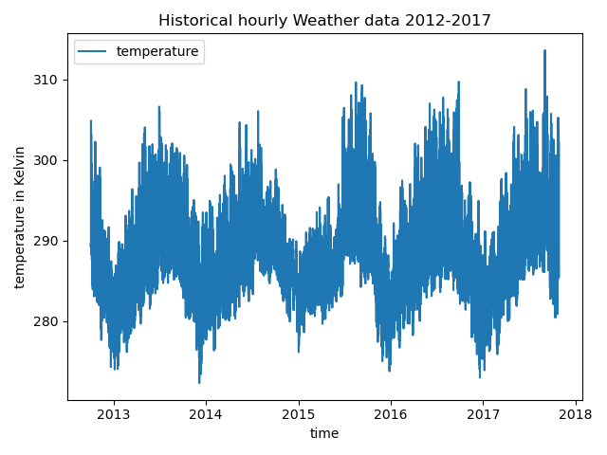
Dependent Variable versus Time
Since it is temperature data, we observe a strong seasonality in the data with a seasonal period of 24 and the data is non-linear. So, I have resampled the data based on seasons summer, winter, fall and autumn.
Summer season data is taken for doing the predictions.

Slide 7
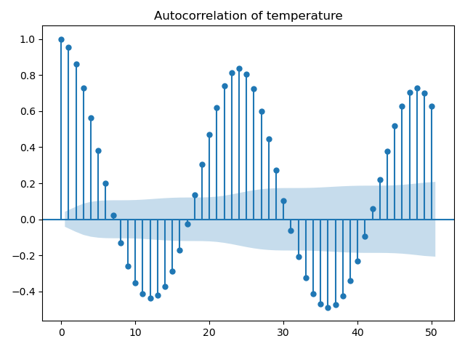
ACF of Dependent Variable
The autocorrelation coefficients of the lagged values for the resampled data of summer season are significant and are not decaying to zero.

Slide 8
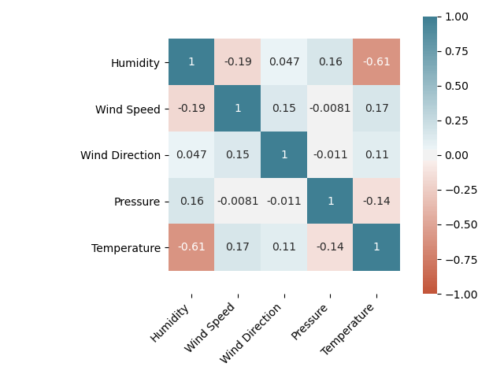
Correlation Matrix
We can observe from the heatmap that there is no multicollinearity exists between the dependent variables.

Slide 9
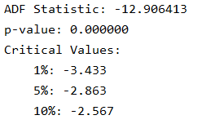
Stationary Test
Performed 24th differencing following by 1st differencing on the dependent variable to make the autocorrelation coefficients decay to zero

Slide 10
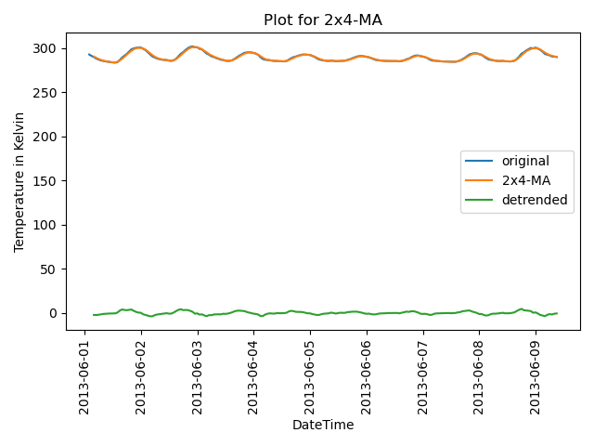
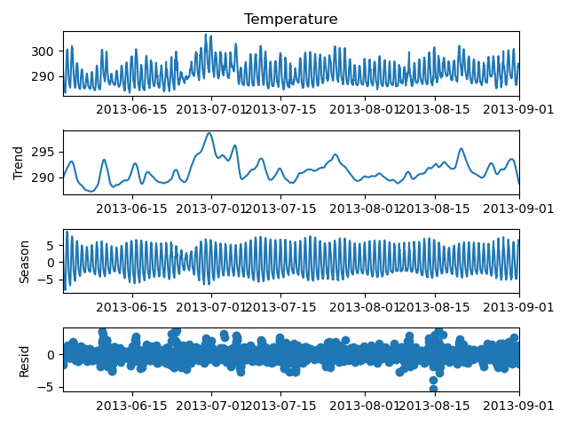
Time Series Decomposition
Moving Average Method
STL Decomposition Method

Slide 11
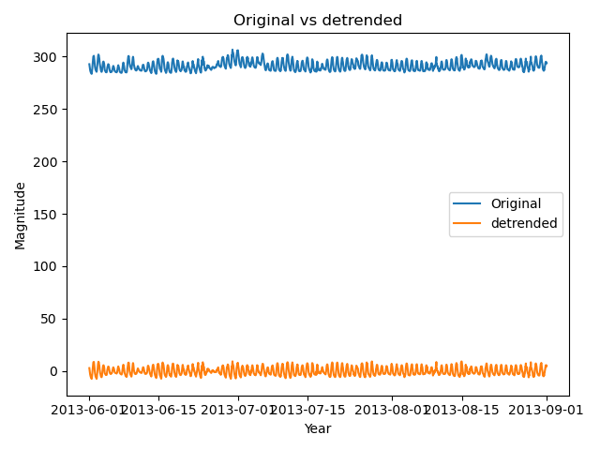
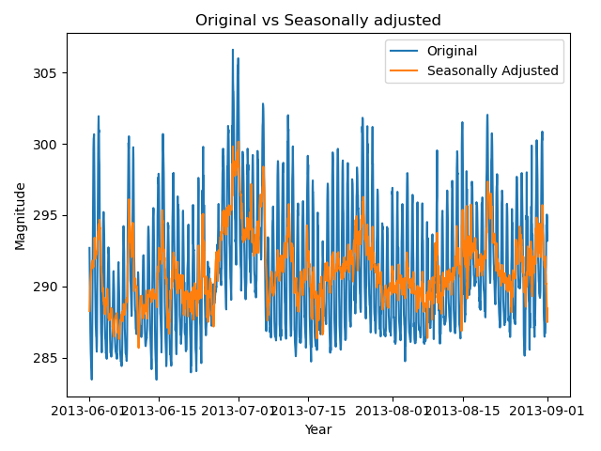
Time Series Decomposition
Strength of trend is 0.86
Seasonality Strength is 0.95

Slide 12
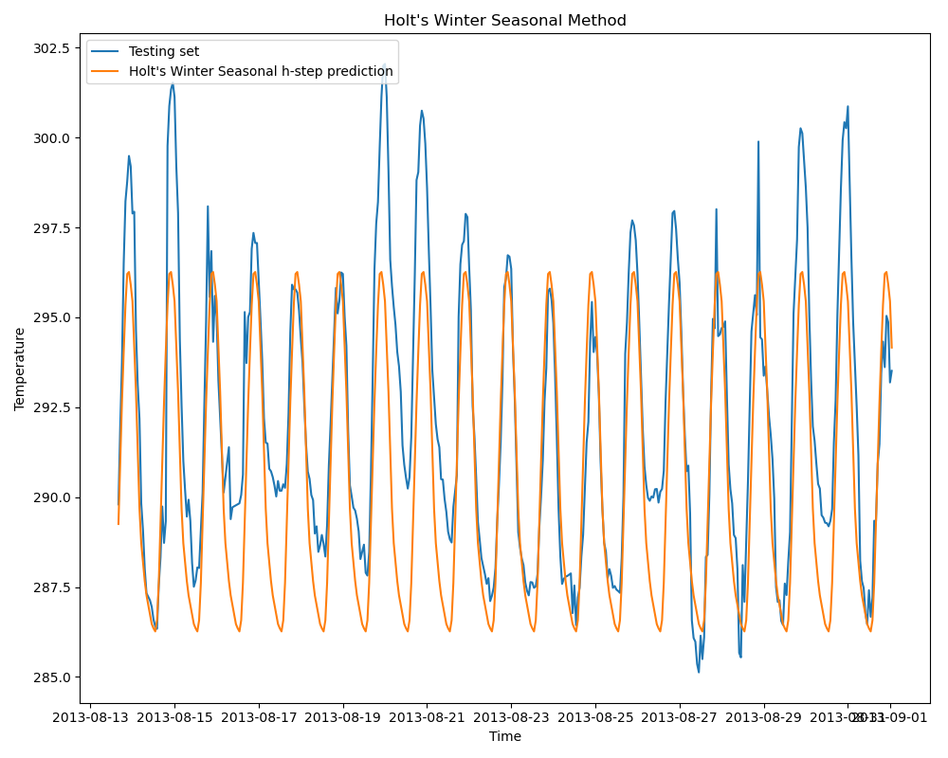
Best Base Model h-step ahead Prediction
Holt’s winter seasonal is best model in fitting the train data and in predicting the forecast values

Slide 13
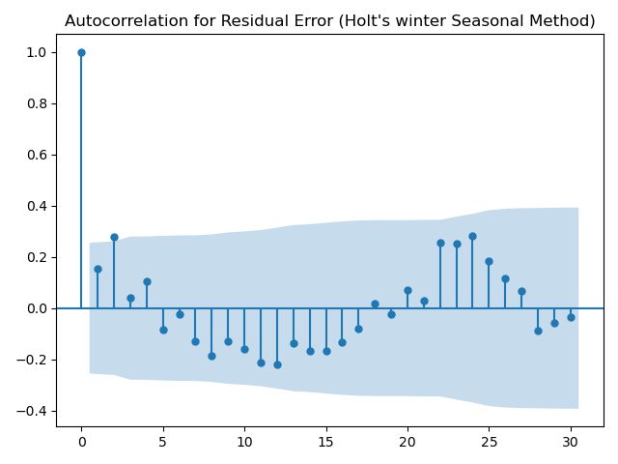
ACF plot of residual error for Best Model
ACF plot of Holt’s winter seasonal show that the residuals are white.

Slide 14
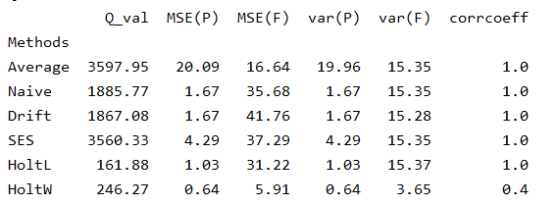
Results of Base Model
Based on MSE and variance of the prediction error and forecast error, we can say that Holt’s winter Seasonal is the best model

Slide 15
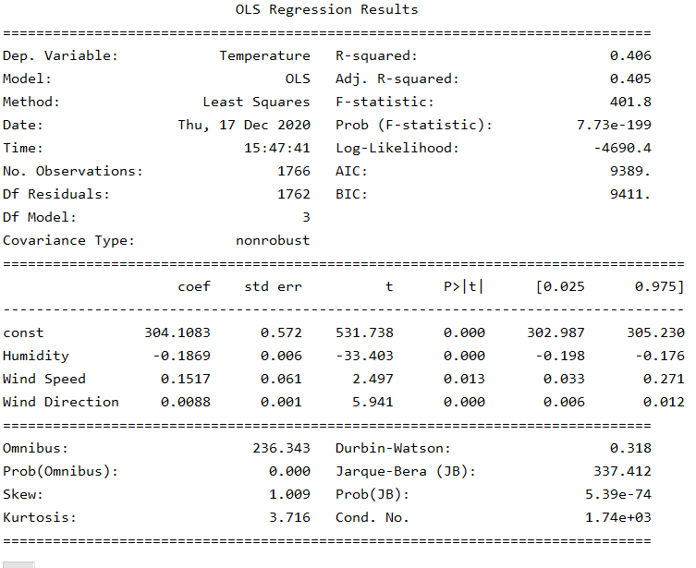
Multiple Linear Regression

Slide 16
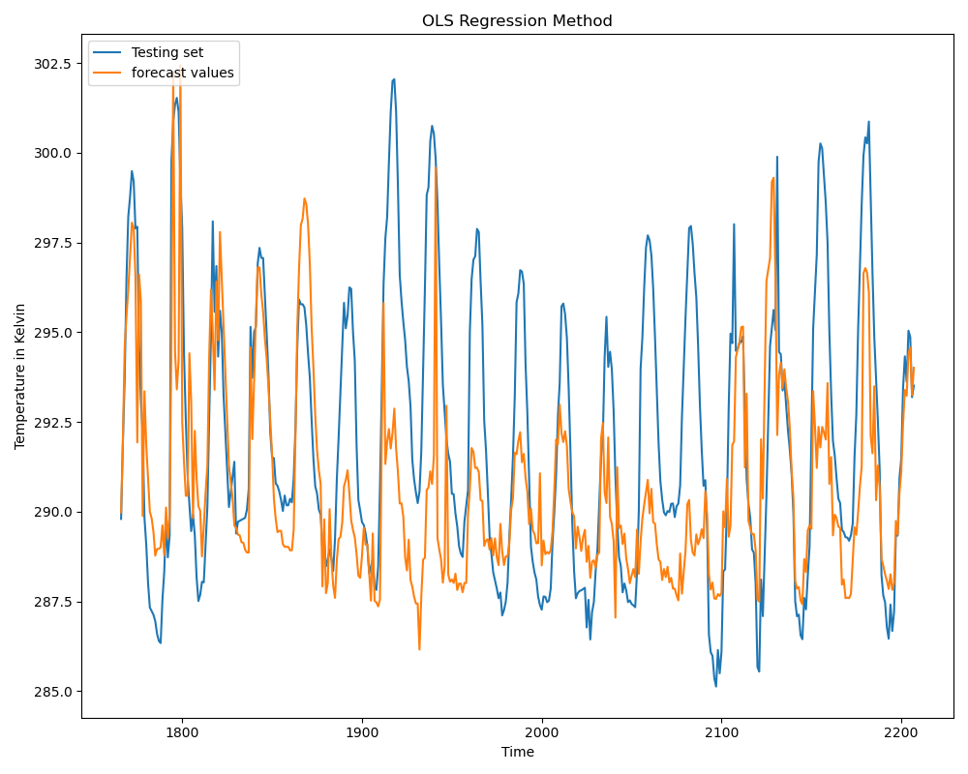
One step ahead Prediction for Multiple Linear regression

Slide 17
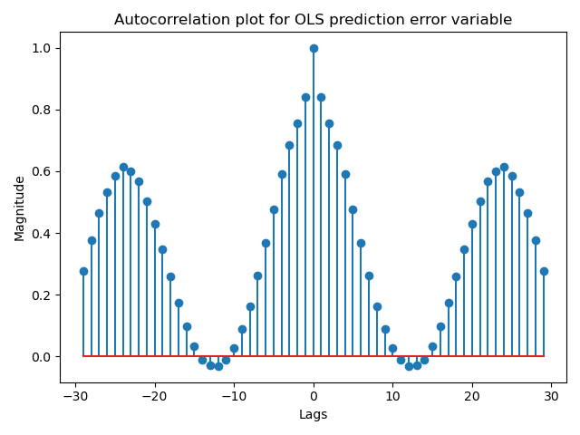
ACF plot of residual error
Coefficients of the lagged values are not decaying to zero.
Adjusted R-squared value is 0.405 which means only 40.5% of variability in data is explained by the model.

Slide 18
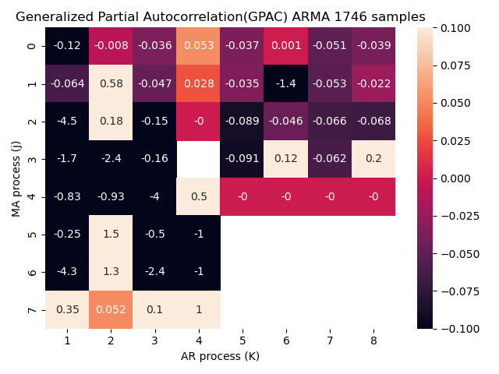
ARMA Model

Slide 19
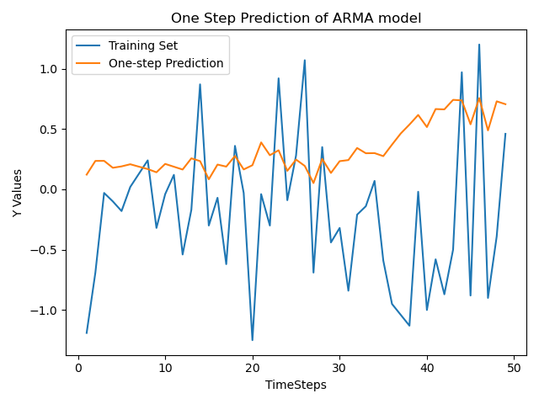
One step prediction ARMA
From the plot, we can observe that ARMA model is not a good fit for the data.

Slide 20
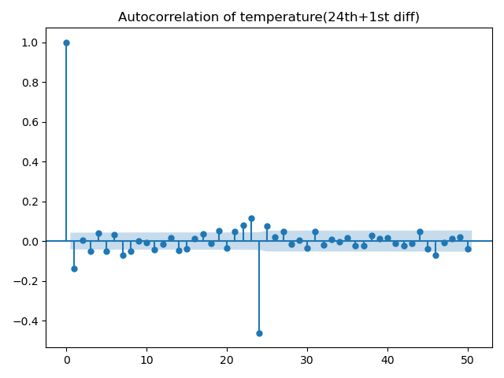
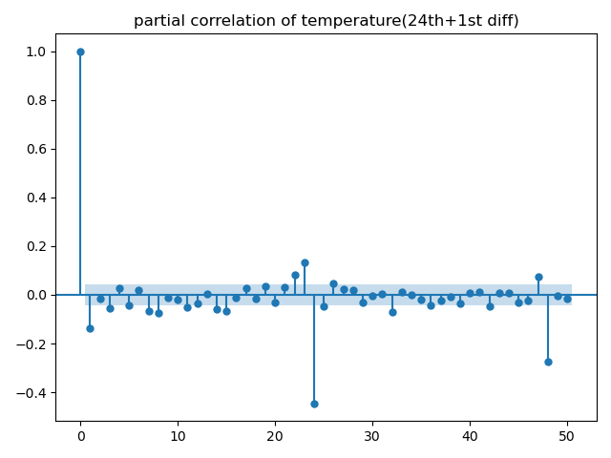
ACF and PACF plots

Slide 21
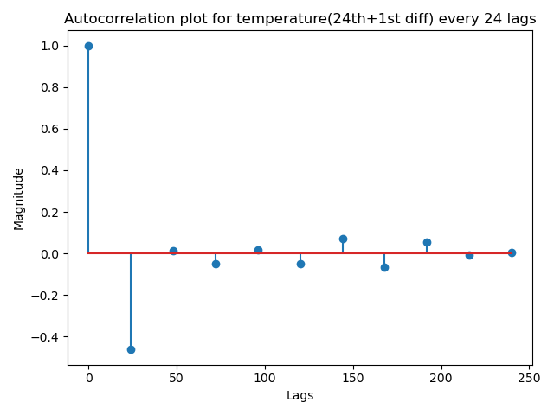
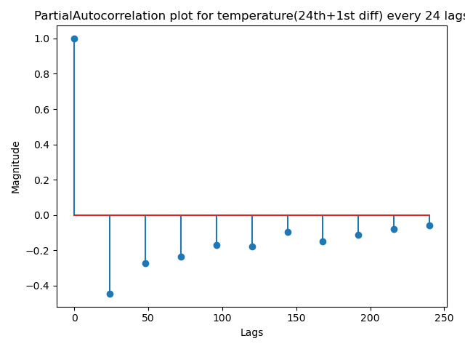
ACF and PACF plots

Slide 22
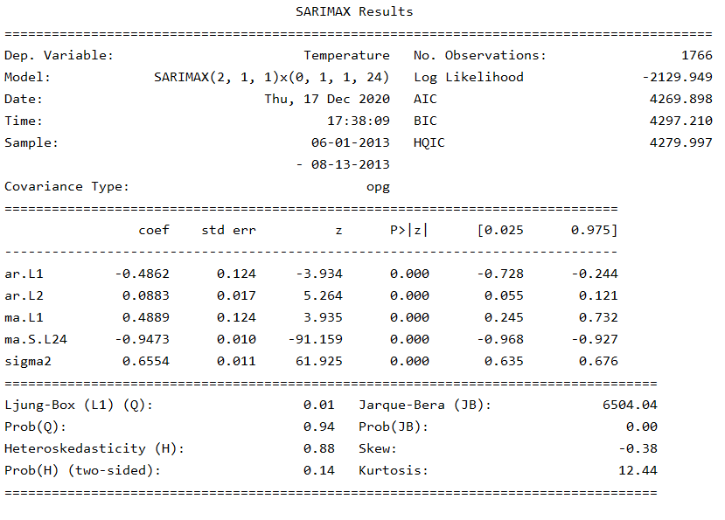
SARIMA Model

Slide 23
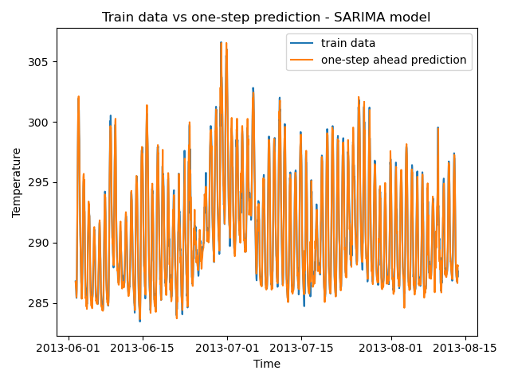
One step ahead prediction SARIMA

Slide 24
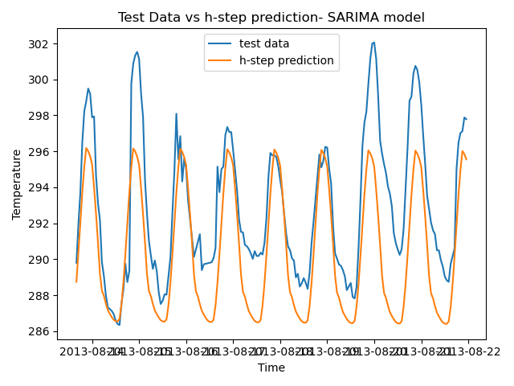
h-step ahead prediction SARIMA

Slide 25
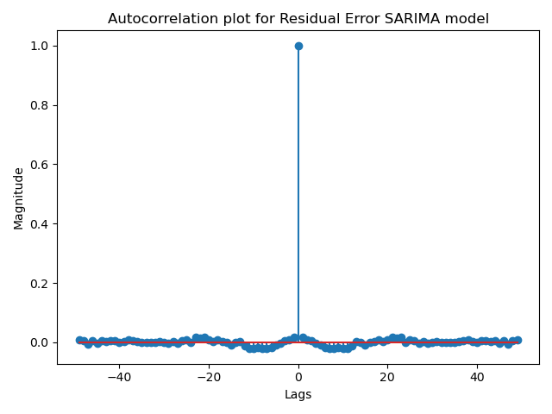
ACF plot of Residual Errors SARIMA
variance of residual error: 13.05
variance of forecast error: 3.82
MSE Residual Error: 13.06
MSE forecast Error: 10.10
Q-value: 7.69

Slide 26
Conclusion
We conclude that Holt’s winter seasonal is better performing model compared to other models.
I have taken an extra step by looking at the SARIMA model which also gave good results. Only limitation with the Holt’s winter seasonal is the Q-value which is large compared to SARIMA. But the ACF plot of the residual errors shows that they are white for both Holt’s winter and SARIMA models.

Slide 27
References
IEEE Paper - THE TIME SERIES APPROACH TO SHORT TERM LOAD FORECASTING” published by Martin T. Hagan and Suzanne M. Behr

Slide 28
Thank You

